Slide 1


Airbnb Price Prediction
Team 7: Ali Ahmad, Haider Waseem, Jiayi Du, Lincy Qin, Samantha Wang
March 14, 2022

Slide 2


Agenda
Exploratory Data Analysis
Feature Engineering
Modeling
Economic Value
Future Work

Slide 3



Business Statement
Host calculates the base rate and researches the price of comparable listings on the market.
Building a smart price prediction tool for Airbnb to offer valuable market insights and help hosts maximize revenue over time.
Successfully listing properties on Airbnb and understanding the market in depth.
Time consuming and limited flexibility

Slide 4
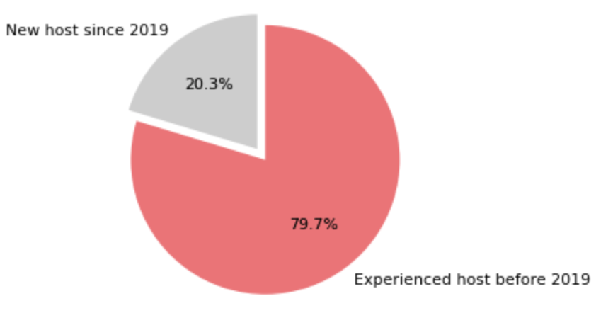
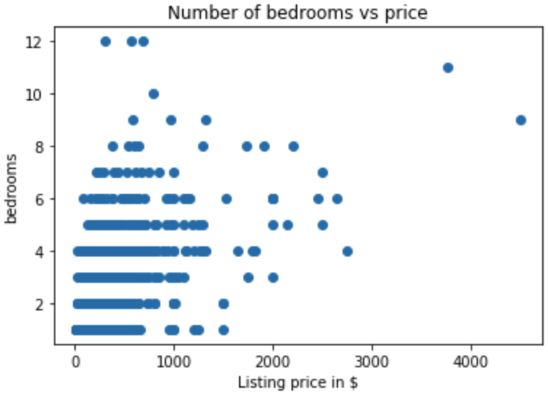
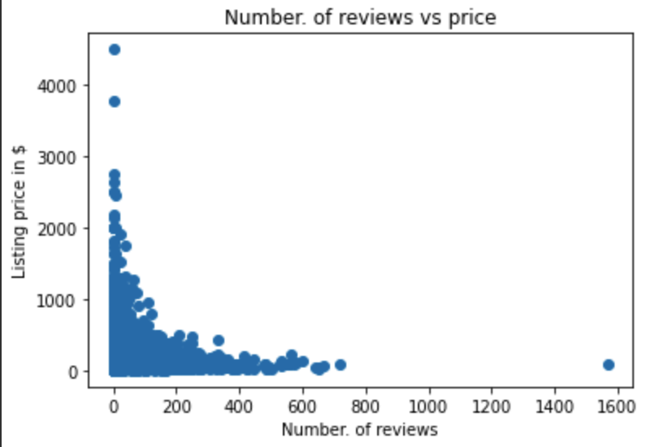
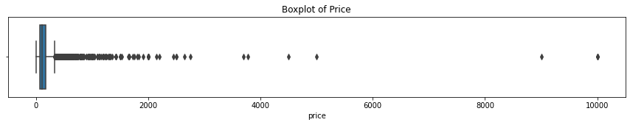
Exploratory Data Analysis
Description of data: Data encapsulates the price for 6,544 Airbnb listings in Chicago in December 2021 with additional 74 explanatory features.
EDA
Feature Engineering
Modeling
Economic Value
Future Work

Slide 5

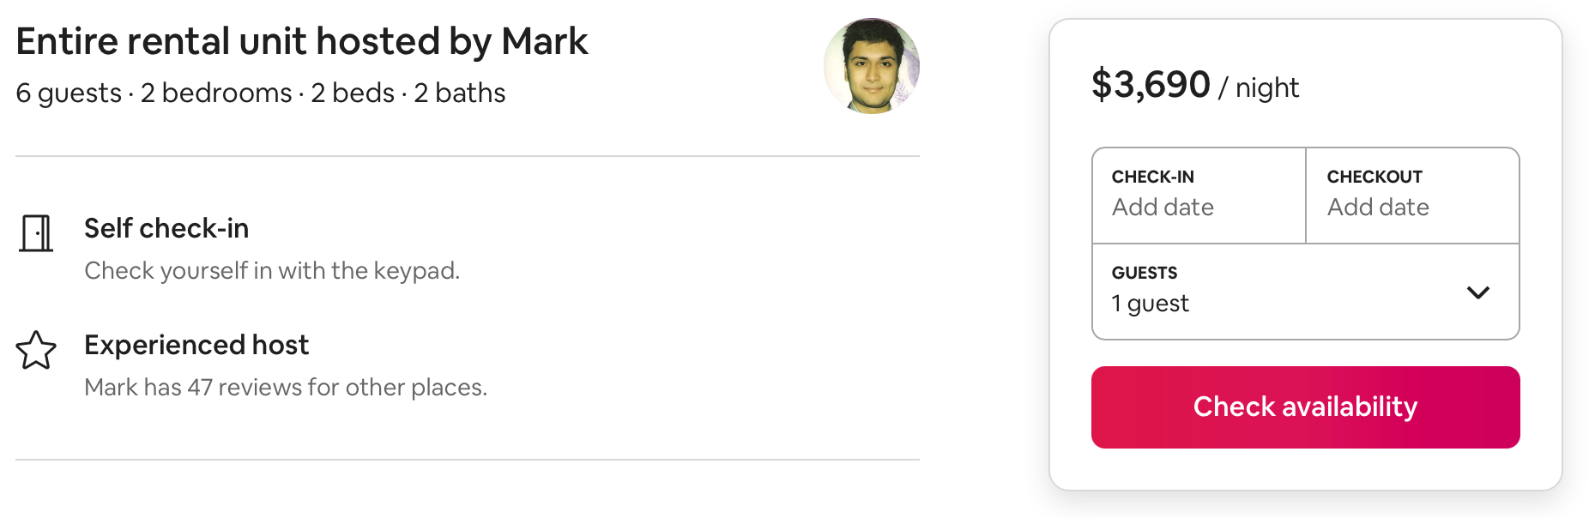
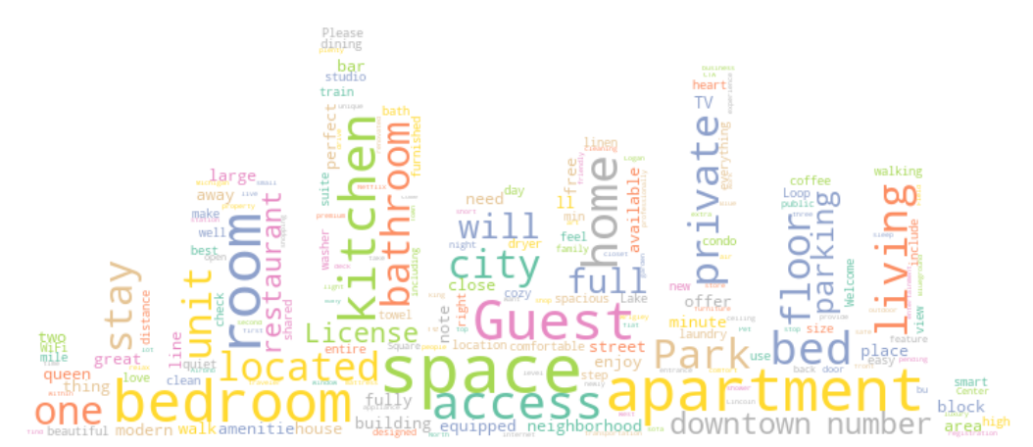
Exploratory Data Analysis
Example of Outlier
Data Delimitation: Listings in the Chicago area in December 2021
Unit of Analysis: Each active Airbnb listing
Data Limitations:
Human Error from website data entry
Monthly rental price used as per night
Experimental Error from ETL process
Web scraping got listings which are outdated
The process of setting price is subjective - large variance of price
Airbnb smart pricing: After cross-examining the information, it will recommend an “ideal” price based on its calculations.
Cons:
Not specific - gives a range
No account for seasonality
A lot of importance given to location
EDA
Feature Engineering
Modeling
Economic Value
Future Work

Slide 6
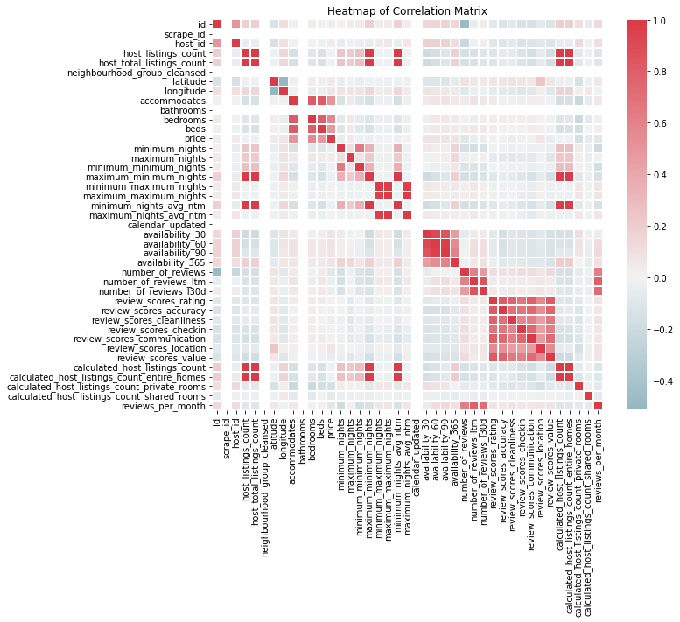
Feature Engineering
id
listing_url
scrape_id
last_scraped
name
description
neighborhood_overview
picture_url
host_id
host_url
host_name
host_since
host_location
host_about
host_response_time
host_response_rate
host_acceptance_rate
host_is_superhost
host_thumbnail_url
host_picture_url
host_neighbourhood
host_listings_count
host_total_listings_count
host_verifications
host_has_profile_pic
host_identity_verified
neighbourhood
neighbourhood_cleansed
neighbourhood_group_cleansed
latitude
longitude
property_type
room_type
accommodates
bathrooms
bathrooms_text
bedrooms
beds
amenities
price
minimum_nights
maximum_nights
minimum_minimum_nights
maximum_minimum_nights
minimum_maximum_nights maximum_maximum_nights
minimum_nights_avg_ntm
maximum_nights_avg_ntm
calendar_updated
has_availability
availability_30
availability_60
availability_90
availability_365
calendar_last_scraped
number_of_reviews
number_of_reviews_ltm
number_of_reviews_l30d
first_review last_review
review_scores_rating
review_scores_accuracy
review_scores_cleanliness
review_scores_checkin
review_scores_communication
review_scores_location
review_scores_value
license
instant_bookable
calculated_host_listings_count calculated_host_listings_count_entire_homes calculated_host_listings_count_private_rooms calculated_host_listings_count_shared_rooms reviews_per_month
EDA
Feature Engineering
Modeling
Economic Value
Future Work

Slide 7
Feature Engineering
host_id
host_url
host_name
host_since
host_location
host_about
host_response_time
host_response_rate
host_acceptance_rate
host_is_superhost
host_thumbnail_url
host_picture_url
host_neighbourhood
host_listings_count
host_total_listings_count
host_verifications
host_has_profile_pic
host_identity_verified
id
listing_url
scrape_id
last_scraped
name
description
neighborhood_overview
picture_url
neighbourhood
neighbourhood_cleansed
neighbourhood_group_cleansed
latitude
longitude
property_type
room_type
accommodates
bathrooms
bathrooms_text
bedrooms
beds
amenities
host_id
host_url
host_name
host_since
host_location
host_about
host_response_time
host_response_rate
host_acceptance_rate
host_is_superhost
host_thumbnail_url
host_picture_url
host_neighbourhood
host_listings_count
host_total_listings_count
host_verifications
host_has_profile_pic
host_identity_verified
id
listing_url
scrape_id
last_scraped
name
description
neighborhood_overview
picture_url
neighbourhood
neighbourhood_cleansed
neighbourhood_group_cleansed
latitude
longitude
property_type
room_type
accommodates
bathrooms
bathrooms_text
bedrooms
beds
amenities
price
minimum_nights
maximum_nights
minimum_minimum_nights
maximum_minimum_nights
minimum_maximum_nights
maximum_maximum_nights
minimum_nights_avg_ntm
maximum_nights_avg_ntm
calendar_updated
has_availability
availability_30
availability_60
availability_90
availability_365
calendar_last_scraped
price
minimum_nights
maximum_nights
minimum_minimum_nights
maximum_minimum_nights
minimum_maximum_nights
maximum_maximum_nights
minimum_nights_avg_ntm
maximum_nights_avg_ntm
calendar_updated
has_availability
availability_30
availability_60
availability_90
availability_365
calendar_last_scraped
number_of_reviews
number_of_reviews_ltm
number_of_reviews_l30d
first_review last_review
review_scores_rating
review_scores_accuracy
review_scores_cleanliness
review_scores_checkin
review_scores_communication
review_scores_location
review_scores_value
license
instant_bookable
calculated_host_listings_count calculated_host_listings_count_entire_homes calculated_host_listings_count_private_rooms calculated_host_listings_count_shared_rooms reviews_per_month
number_of_reviews
number_of_reviews_ltm
number_of_reviews_l30d
first_review last_review
review_scores_rating
review_scores_accuracy
review_scores_cleanliness
review_scores_checkin
review_scores_communication
review_scores_location
review_scores_value
license
instant_bookable
calculated_host_listings_count calculated_host_listings_count_entire_homes calculated_host_listings_count_private_rooms calculated_host_listings_count_shared_rooms reviews_per_month
EDA
Feature Engineering
Modeling
Economic Value
Future Work

Slide 8
Feature Engineering
free_street_parking
free_parking_on_premises
first_aid_kit
shower_gel
fire_extinguisher
indoor_fireplace
paid_parking_off_premises
air_conditioning
long_term_stays_allowed
gym
outdoor_furniture
patio_or_balcony
washer
lock_on_bedroom_door
private_entrance
heating
laundromat_nearby
lockbox
hair_dryer
room-darkening_shades
dishwasher
elevator
tv
hangers
keypad
coffee_maker
dryer
bbq_grill
hot_water
oven
bathtub
wine_glasses
baking_sheet
neighbourhood_farnorth
neighbourhood_farsouth
neighbourhood_farsouthwest
neighbourhood_north
neighbourhood_northwest
neighbourhood_south
neighbourhood_southwest
neighbourhood_west
host_since
host_response_time
host_acceptance_rate
host_is_superhost
host_identity_verified
host_days
response_score
host_acceptance_rate
host_is_superhost
host_identity_verified
neighbourhood_cleansed
latitude
longitude
dist
has_availability
instant_bookable
availability_90
has_availability
instant_bookable
availability_90
property_group_0
property_group_1
property_group_2
property_group_3
property_group_4
property_type
room_type_entire_home/apt
room_type_hotel_room
room_type_private_room
room_type_shared_room
amenities
room_type
review_scores_rating
review_scores_accuracy
review_scores_cleanliness
review_scores_location
review_scores_value
review1
review2
bedrooms
accommodates
crowdedness
crowdedness_diff
crowdedness_ratio
crowdedness_adj_ratio
bedrooms
accommodates
number_of_reviews
number_of_reviews_ltm
number_of_reviews
number_of_reviews_ltm
bathrooms_text
bathrooms_privacy
bathrooms
minimum_nights
maximum_nights
minimum_nights
maximum_nights
EDA
Feature Engineering
Modeling
Economic Value
Future Work

Slide 9
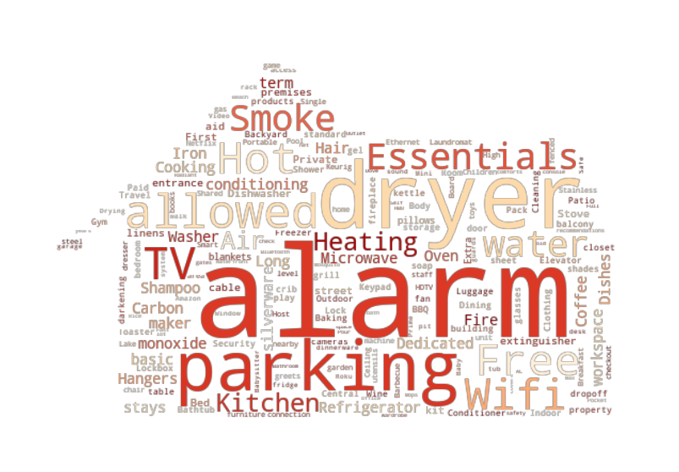
Feature Engineering
Amenities
residential home
guest suite
bed and breakfast
guesthouse
rental unit
townhouse
tiny house
home/apt
hotel
serviced apartment
aparthotel
cabin
farm stay
casa particular
hostel
cottage
bungalow
private room
condo
loft
boutique hotel
boat
place
vacation home
villa
Property Types
EDA
Feature Engineering
Modeling
Economic Value
Future Work

Slide 10
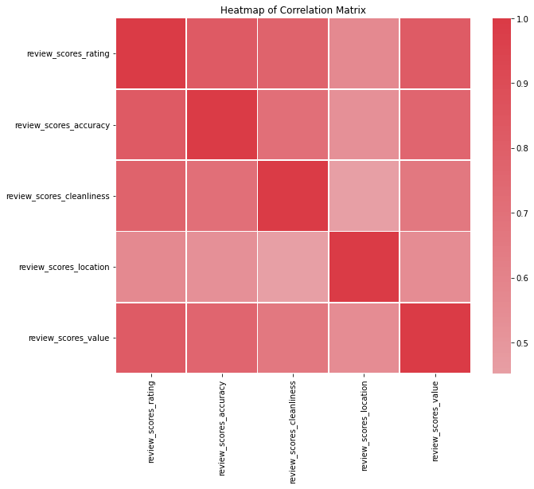
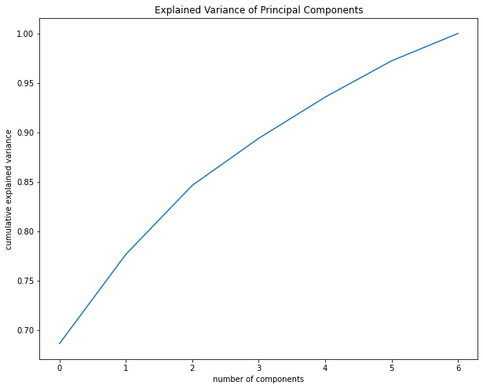
Feature Engineering
Variance Explained by 3 Principal Components: 84.6%
EDA
Feature Engineering
Modeling
Economic Value
Future Work

Slide 11
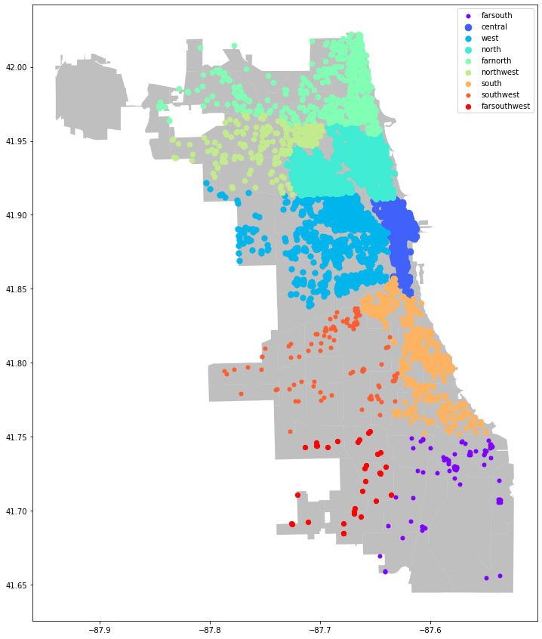
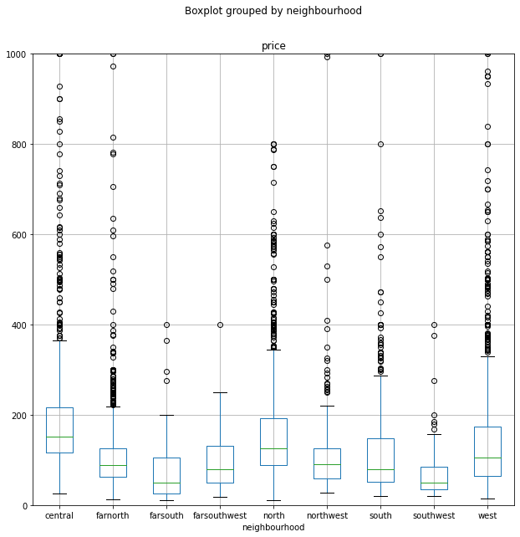
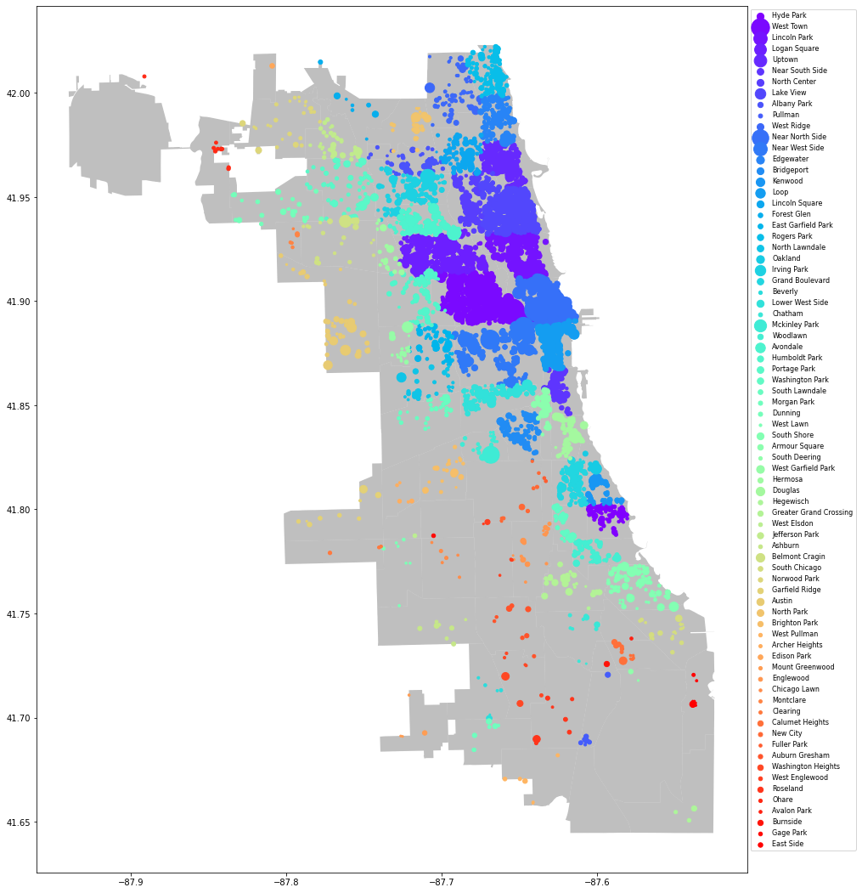
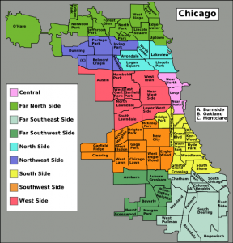
Feature Engineering
The Loop
EDA
Feature Engineering
Modeling
Economic Value
Future Work

Slide 12
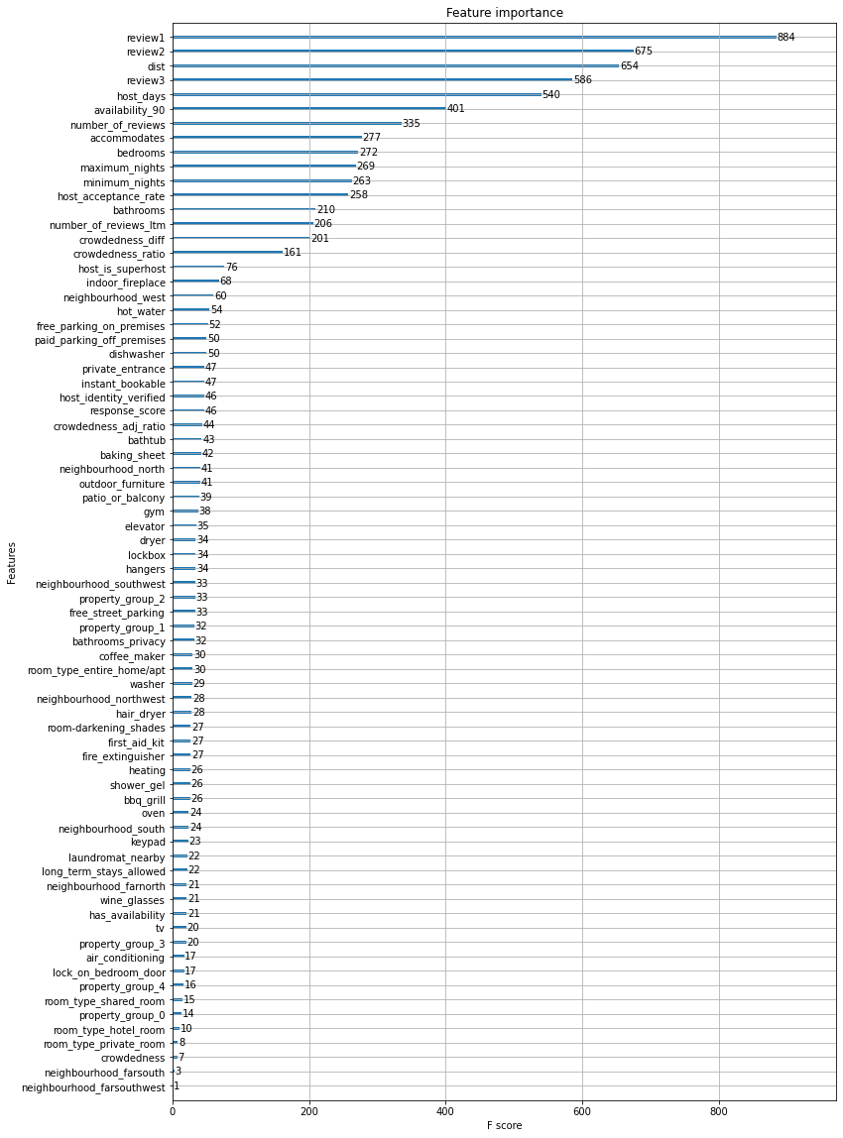
Modeling
Model | Train RMSE | Validation RMSE | CV RMSE | Test RMSE
Decision Tree | 126.44 | 148.06 | 179.46 | 190.05
Linear Regression | 149.71 | 144.32 | 154.94 | 185.18
Gradient Boosting | 28.43 | 125.18 | 150.89 | 176.36
XGBoost | 30.64 | 118.96 | 129.91 | 156.04
Random Forest | 64.55 | 118.72 | 129.13 | 156.96
Multi-layer Perceptron | 124.20 | 124.76 | 152.53 | 165.00
Voting (RF + XGB) | 43.21 | 116.40 | 127.88 | 155.01
Voting (XGB + MLP) | 72.17 | 114.29 | 129.86 | 154.55
Voting (RF + XGB + MLP) | 66.01 | 113.09 | 127.44 | 153.36
XGBoost Feature Importance
EDA
Feature Engineering
Modeling
Economic Value
Future Work

Slide 13


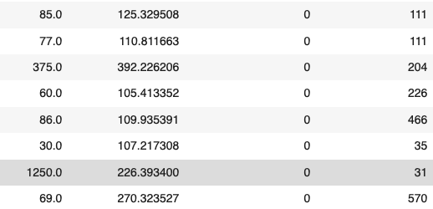
Economic Value
A new host may be looking to sublease their house, but are new to the market. Our recommendation engine would offer a suggested price range based on market competition.
As experienced hosts find their booking rate dropping, our market research would help them understand the desired price shift. Our model would suggest optimal pricing and facilitate in increasing booking rate.
Listing Price
Suggested Price
Review Numbers
Days as Host
Our model finds the balance between maximizing host revenue and customer generation. Among 188 new hosts, these listings can potentially generate 8K revenue at the predicted price.
EDA
Feature Engineering
Modeling
Economic Value
Future Work

Slide 14

Economic Value
Future Work
MORE CONVENIENT PRICING FOR HOSTS
Set up the most competitive price for new host listing’s and offer experienced hosts greater market insights.
ROBUST AGAINST MARKET VOLATILITY
Hosts can exercise a dynamic listing strategy with greater flexibility in a volatile business environment. Our model helps sustain revenues in novel circumstances such as Covid, new regulations, etc.
Methodology
Study the customer-side of the market with graph theory and social network analysis
Feature Mining
Use NLP on reviews to extract keywords and generate labels.
Utilize image recognition on posted pictures to identify differentiating features
CUSTOMER ENGAGEMENT
By offering a more balanced price, we can increase customer retention rate and bookings.
Extend Analysis Scope
Extend the analysis to more regions in the U.S. and worldwide.
Incorporate time series analysis to predict price.
EDA
Feature Engineering
Modeling
Economic Value
Future Work

Slide 15

Thank You

